Slide 1

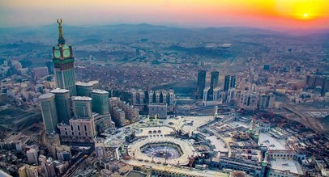

West Monthly VIR Assessment MAKKAH Nov-2021 to Feb -2022
Annual Report 2020 | stc group
Saudi Arabia

Slide 2
2G
Makkah VIR

Slide 3
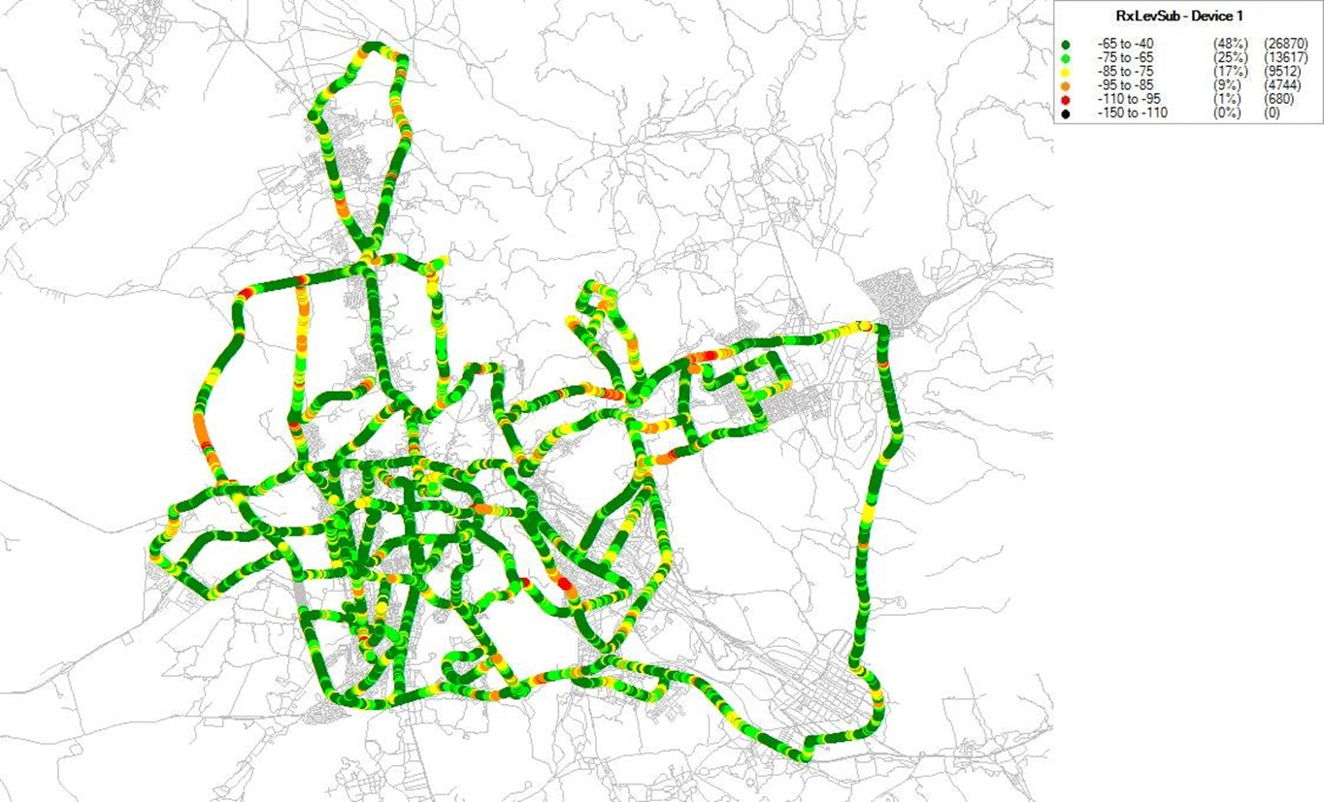
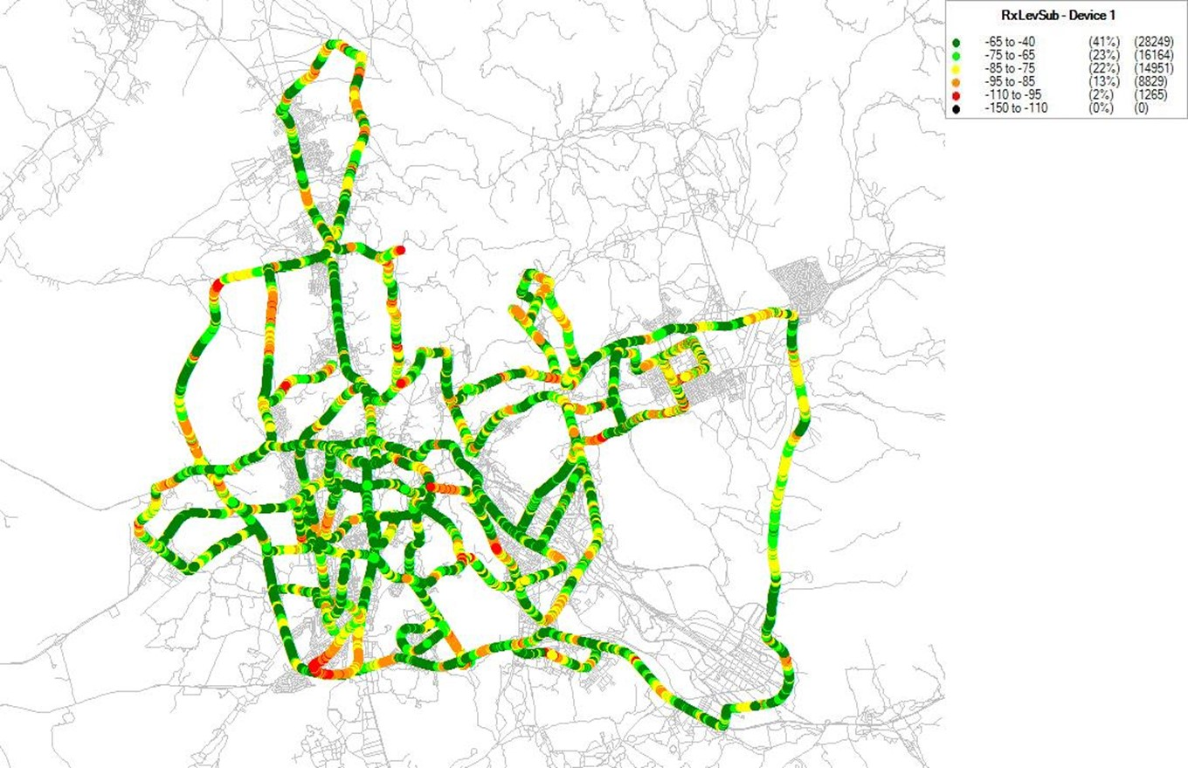
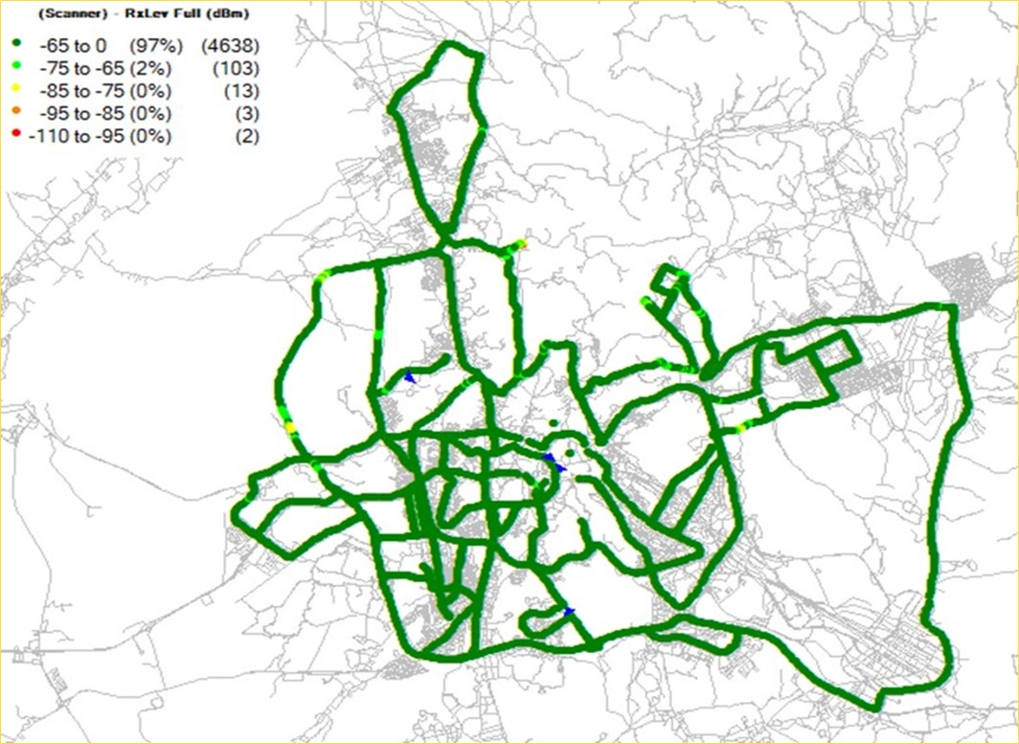
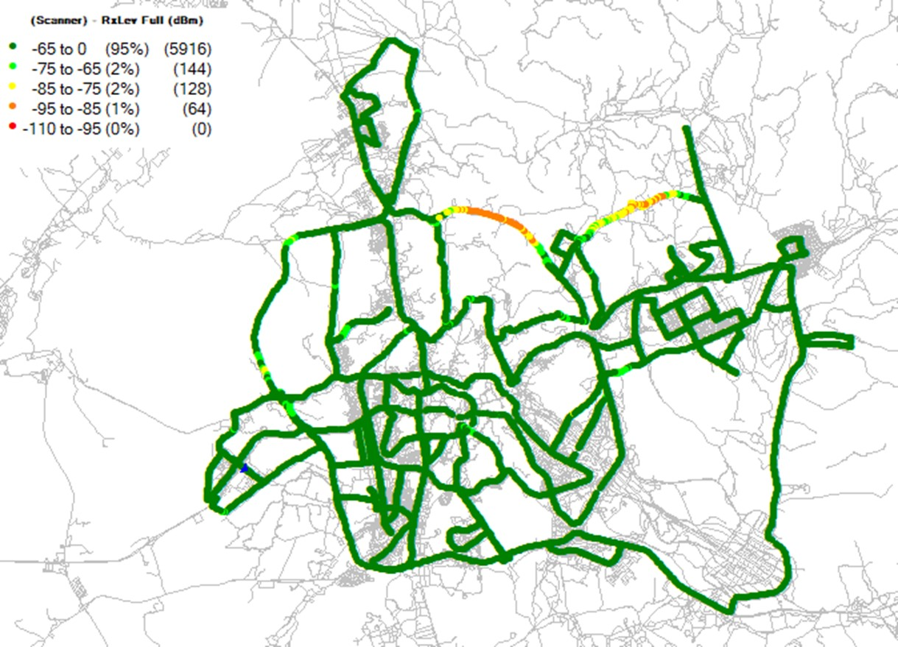
Makkah VIR 2G Coverage Comparison
Nov-2021
Dec-2021
Jan-2022
Rx-Level
New route was added on Feb Vir Drive
4th Ring road which has no dedicated sites
New planned site ZMK920 and ZMK861 will cover 4th ring road
Feb-2022

Slide 4
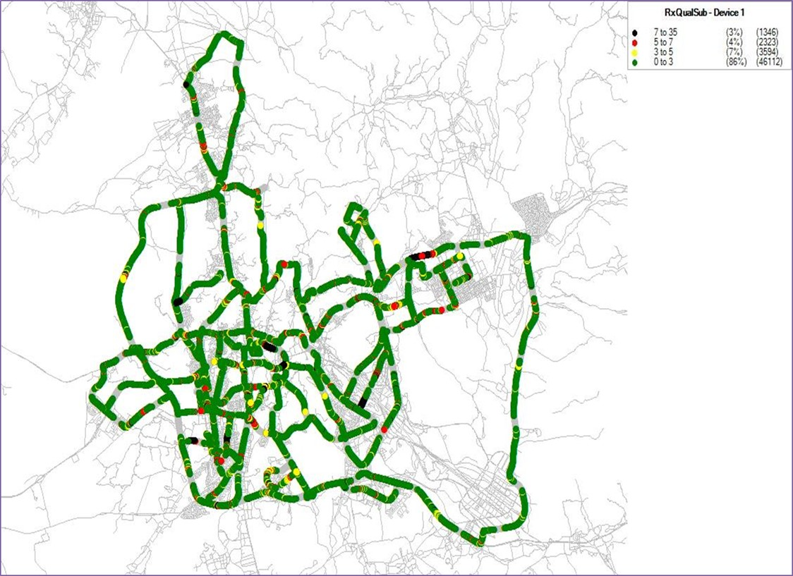
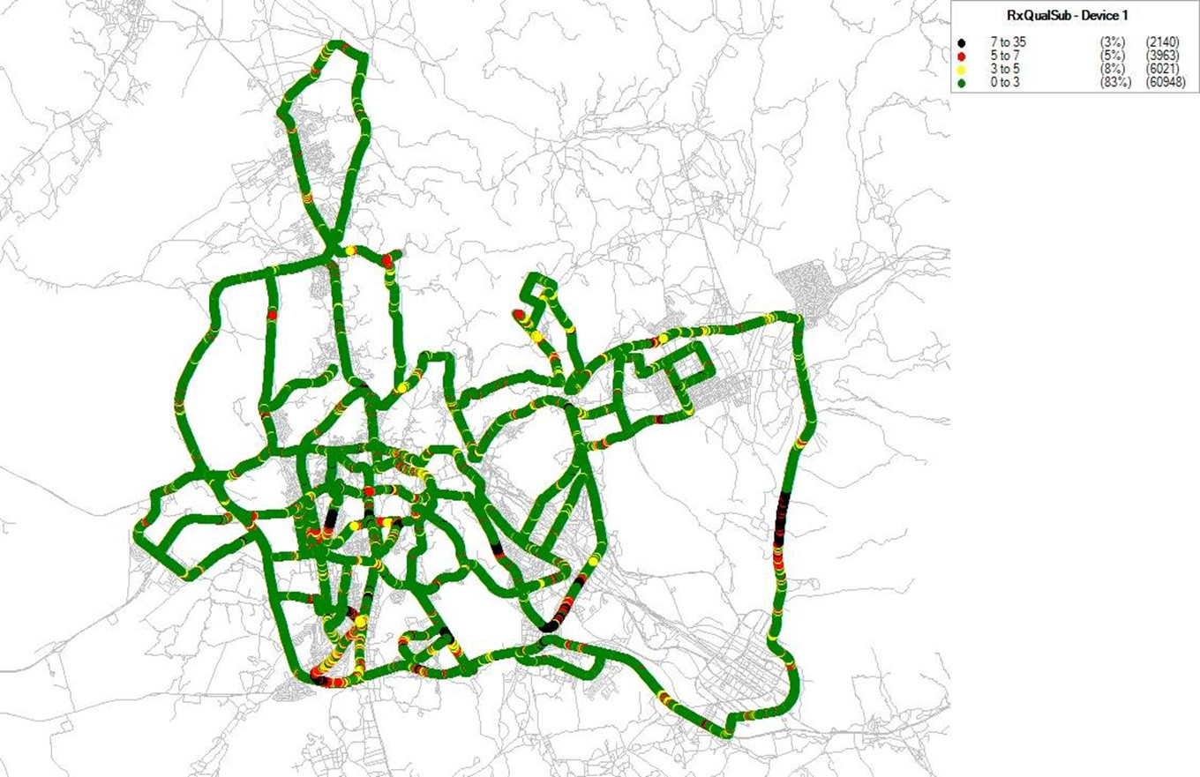
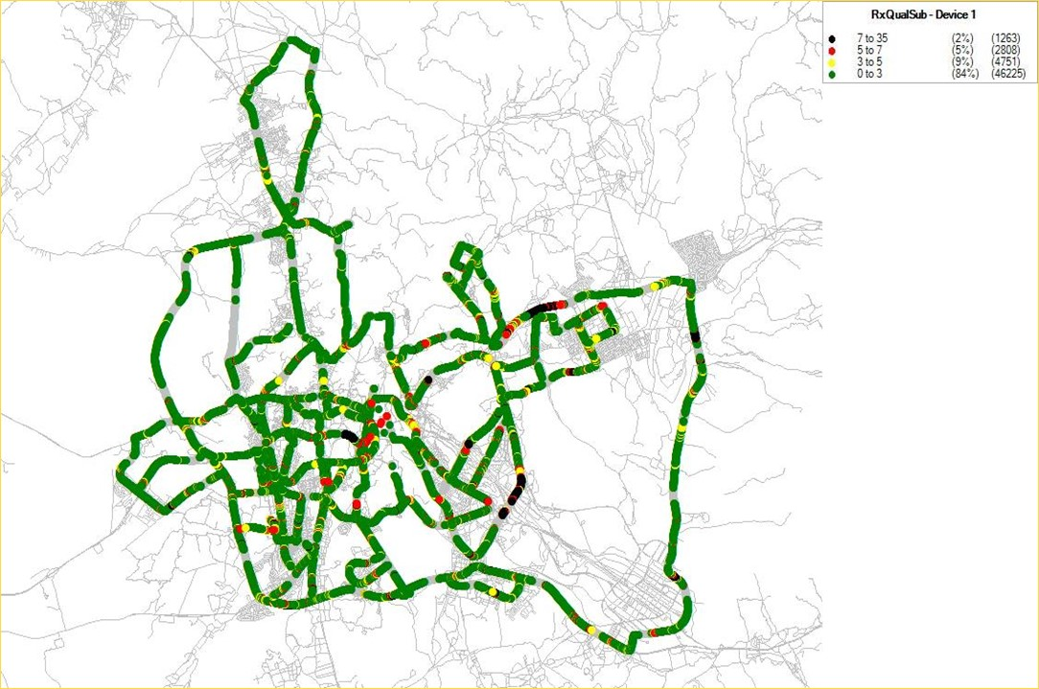
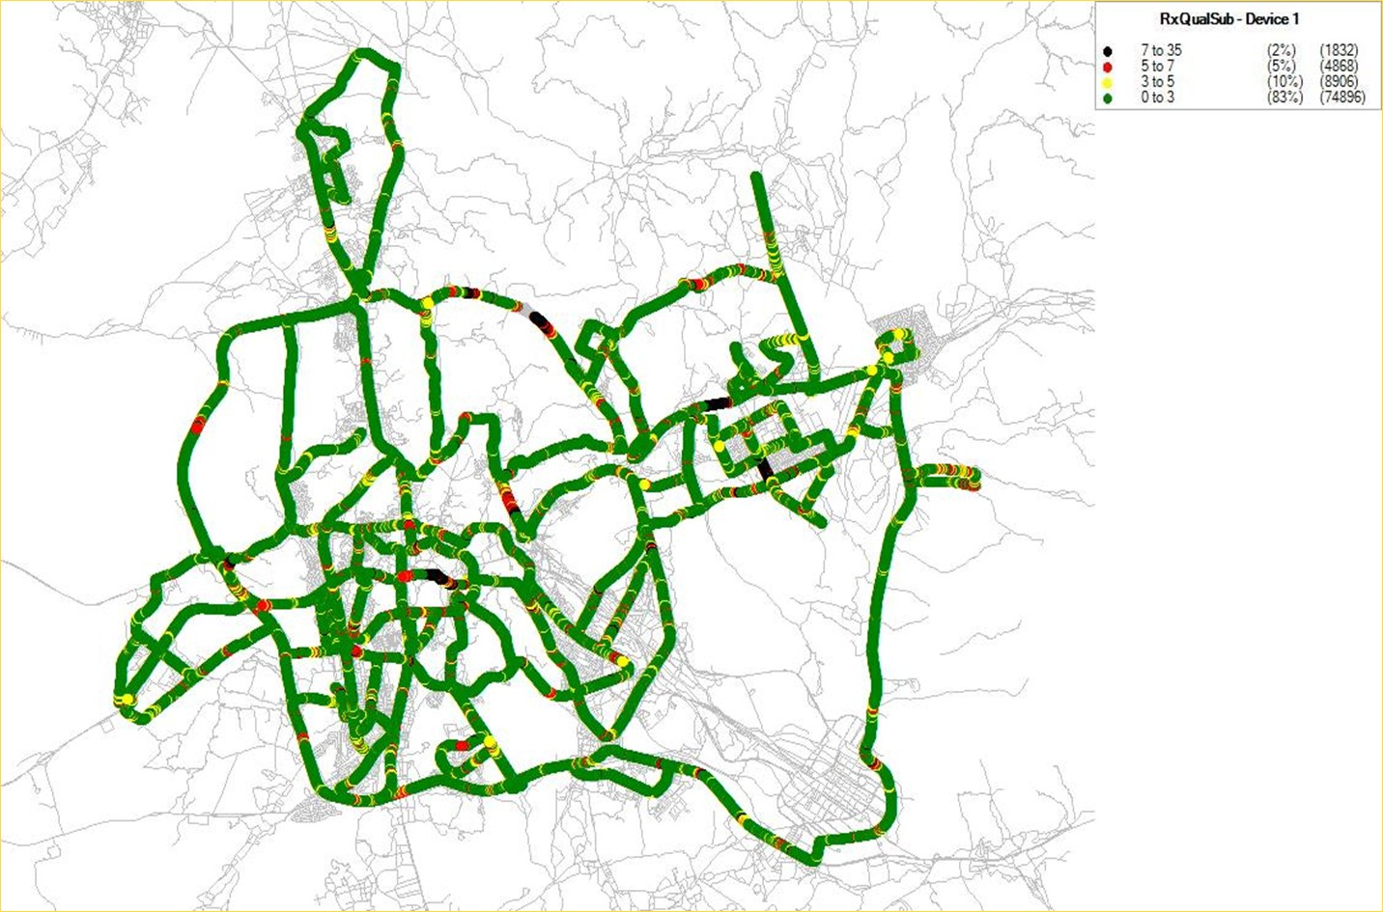
Makkah VIR 2G Quality Comparison
Nov-2021
Dec-2021
Jan-2022
Rx-Quality
Feb-2022

Slide 5
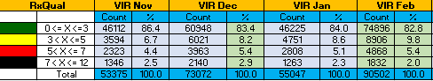
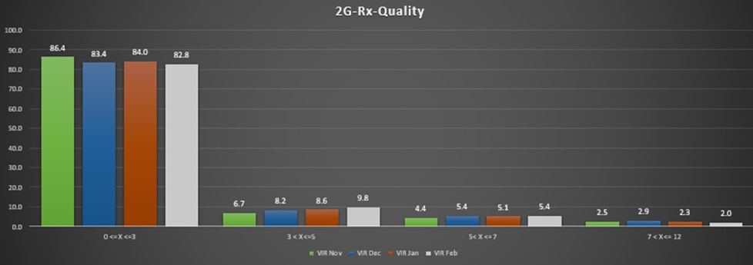
Makkah VIR 2G Quality Comparison
For 2G quality is in normal trend

Slide 6
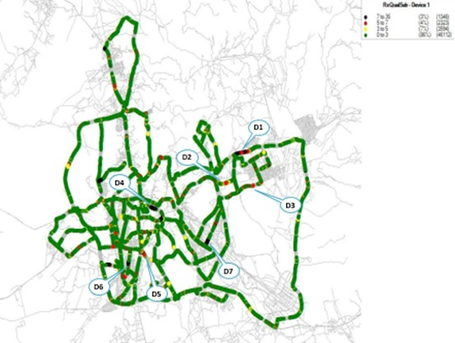
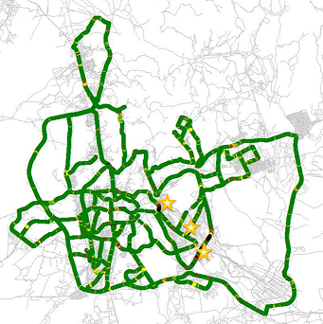
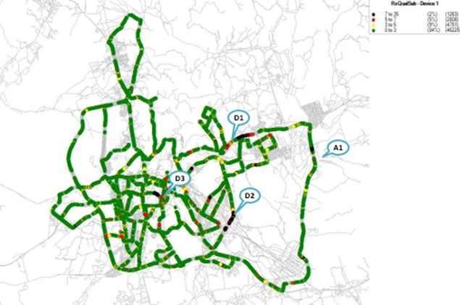

Makkah VIR 2G Events Comparison
Nov-2021
Dec-2021
Jan-2022
Dropped was exist in different location compared with monthly
Most drop due to outage sites, FIF, delay HO
Drop in 4th ring road due to no sites ( New planned site ZMK920 and ZMK861)
Feb-2022

Slide 7
Makkah VIR 2G Events Comparison
Events | Nov | Dec | Jan | Feb | Mac | April | May | June | July | Sept | Oct | Nov | Dec
Call Attempts | 159 | 35 | 166 | 40
Call End successfully | 159 | 32 | 166 | 40
Call Dropped | 7 | 3 | 3 | 3
Call re establishment | 0 | 0 | 0 | 0
Dropped was exist in different location compared with monthly
Most drop due to outage sites, FIF, delay HO
Drop in 4th ring road due to no sites ( New planned site ZMK920 and ZMK861)

Slide 8
3G
Makkah VIR

Slide 9
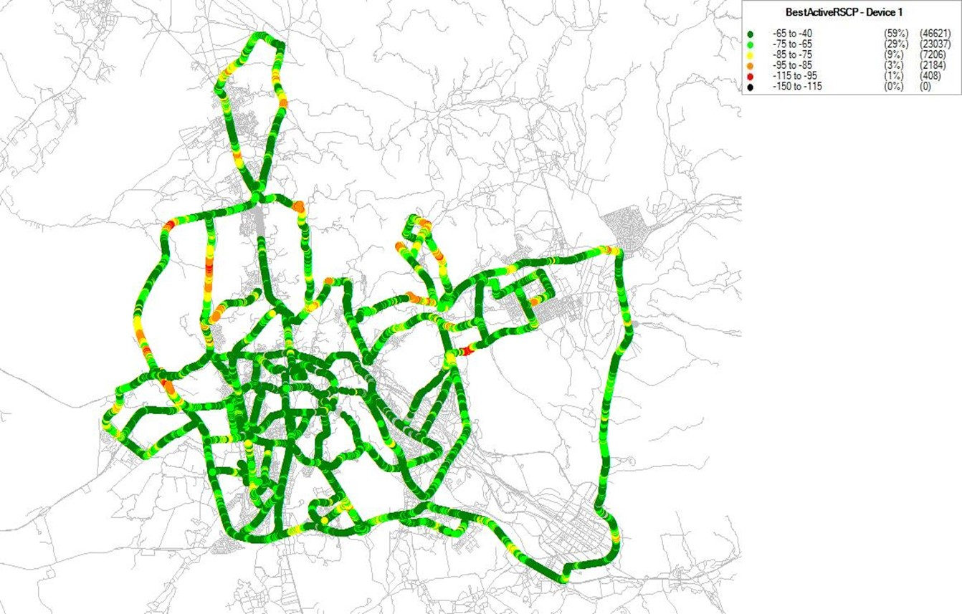
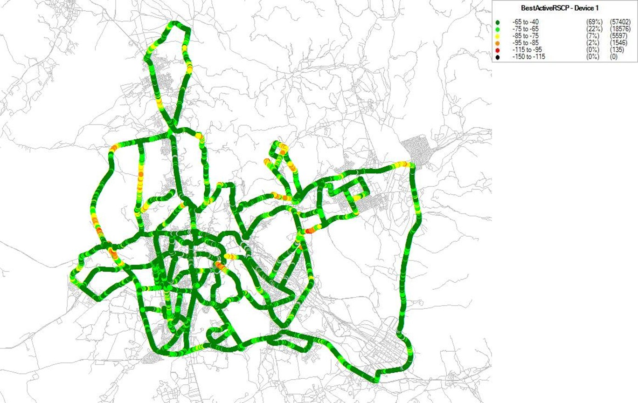
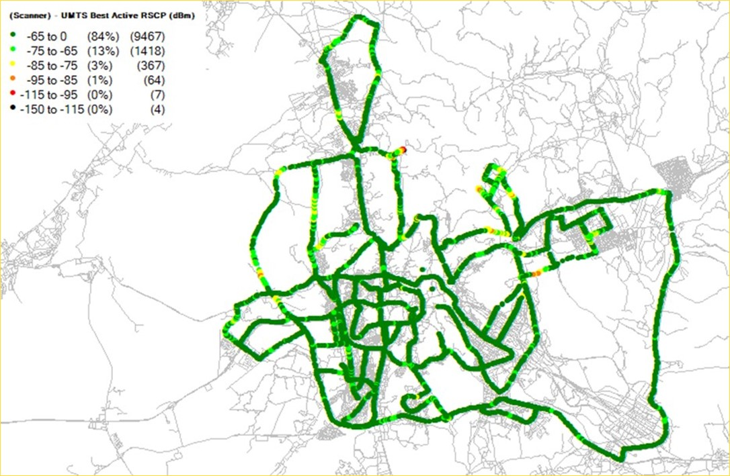
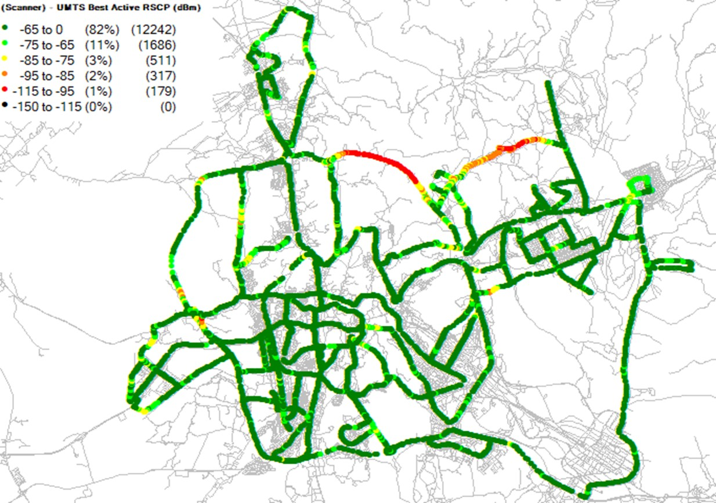
Makkah VIR 3G Coverage Comparison
Nov-2021
Dec-2021
Jan-2022
3G-RSCP
New route was added on Feb Vir Drive
4th Ring road which has no dedicated sites
New planned site ZMK920 and ZMK861 will cover 4th ring road
Feb-2022

Slide 10
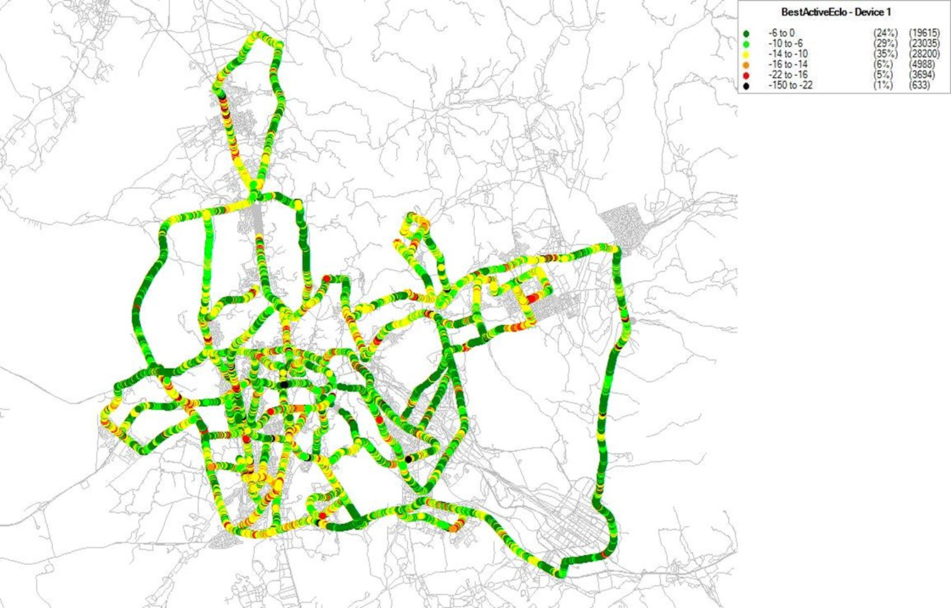
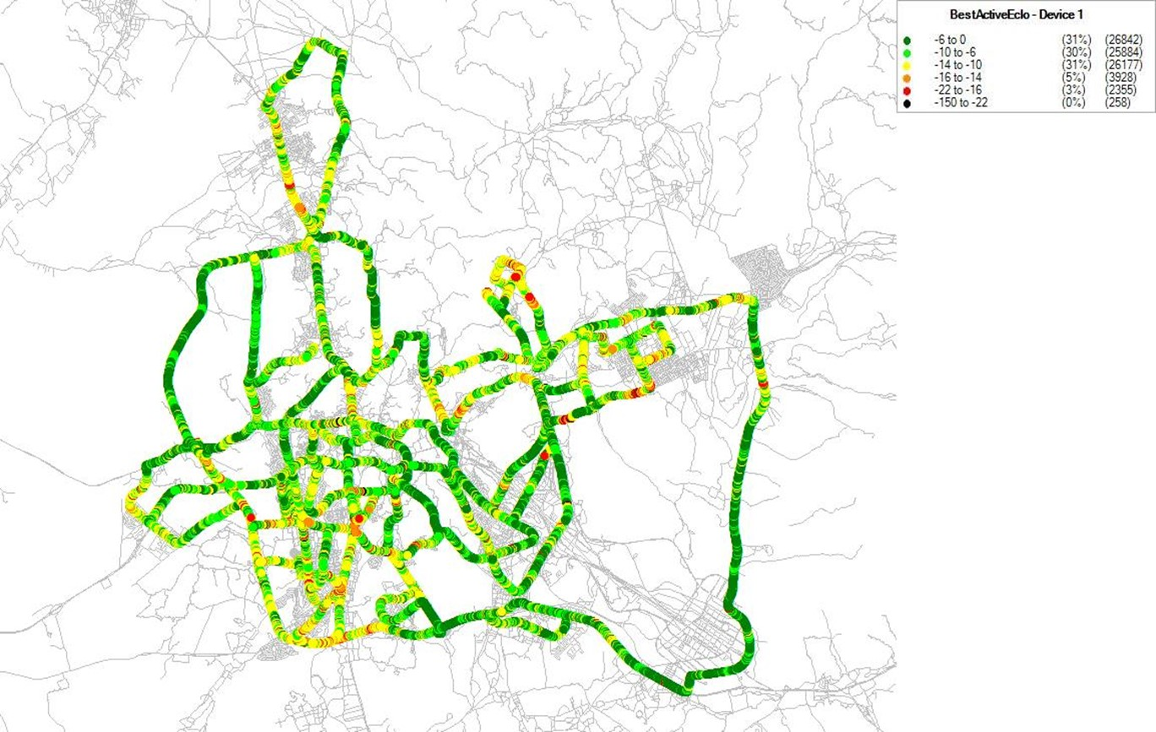
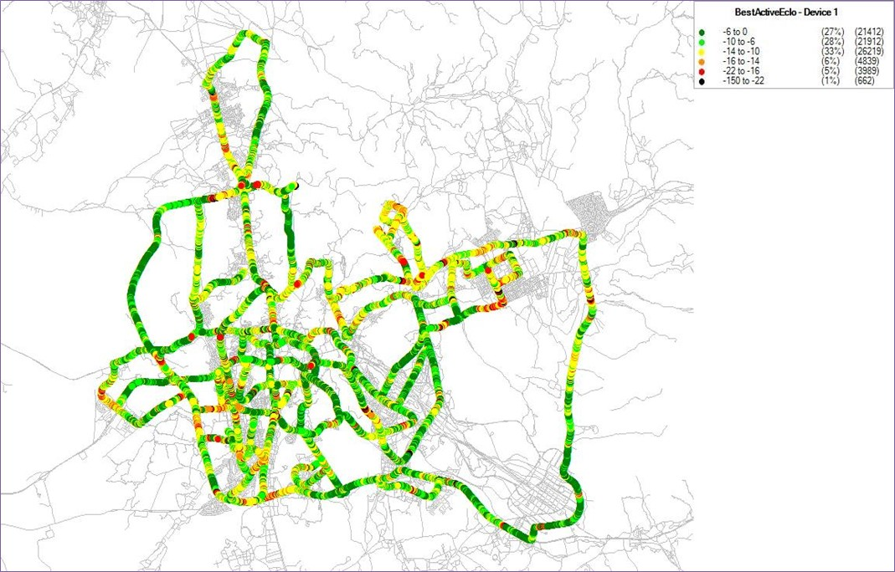
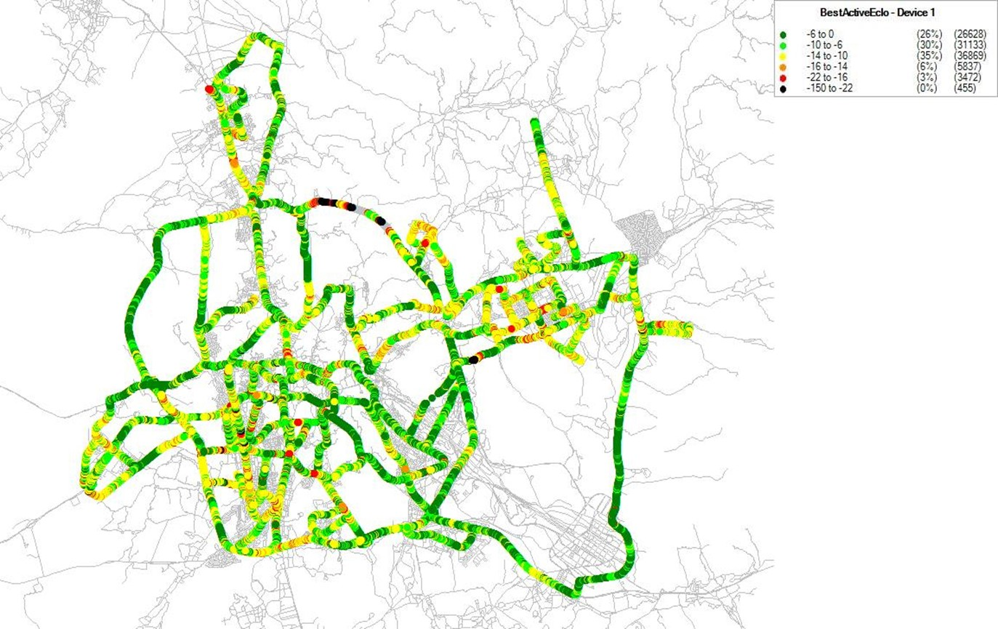
Makkah VIR 3G Ec/No Comparison
Nov-2021
Dec-2021
Jan-2022
3G-Ec/No
Feb-2022

Slide 11
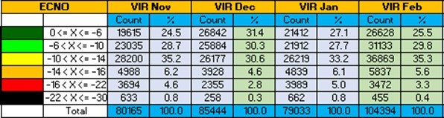
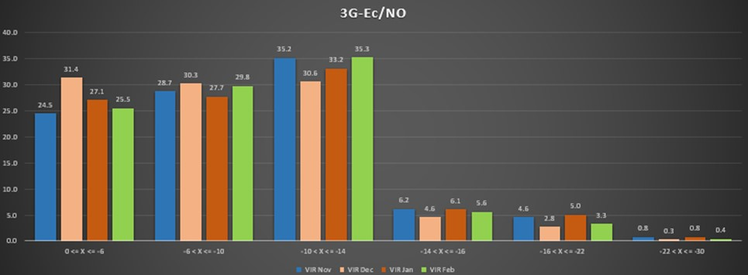
Makkah VIR 3G Ec/No Comparison

Slide 12
Makkah VIR 3G Events Comparison
No drop
No drop
No drop
No drop
Nov-2021
Dec-2021
Jan-2022
Feb-2022

Slide 13
Makkah VIR 3G Events Comparison
Events | Nov | Dec | Jan | Feb | Mac | April | May | June | July | Sept | Oct | Nov | Dec
Call Attempts | 169 | 20 | 171 | 20
Call End successfully | 169 | 20 | 171 | 20
Call Dropped | 0 | 0 | 0 | 0
Call re establishment | 5 | 4 | 6 | 4

Slide 14
4G
Makkah VIR

Slide 15
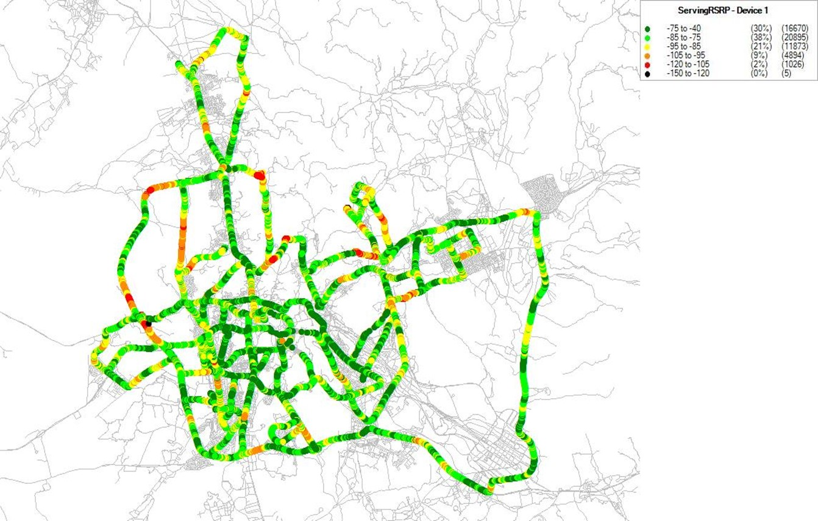
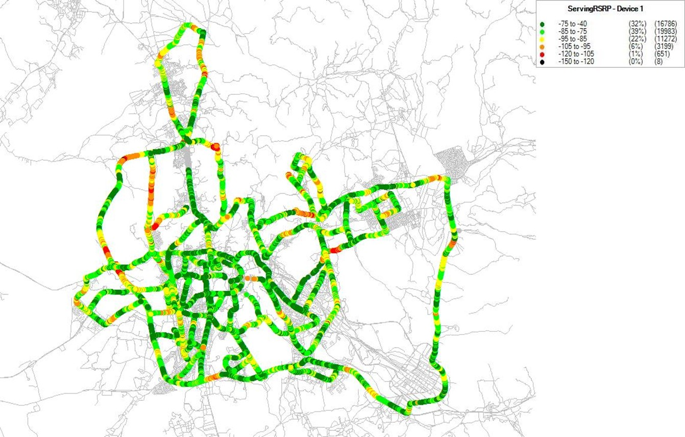
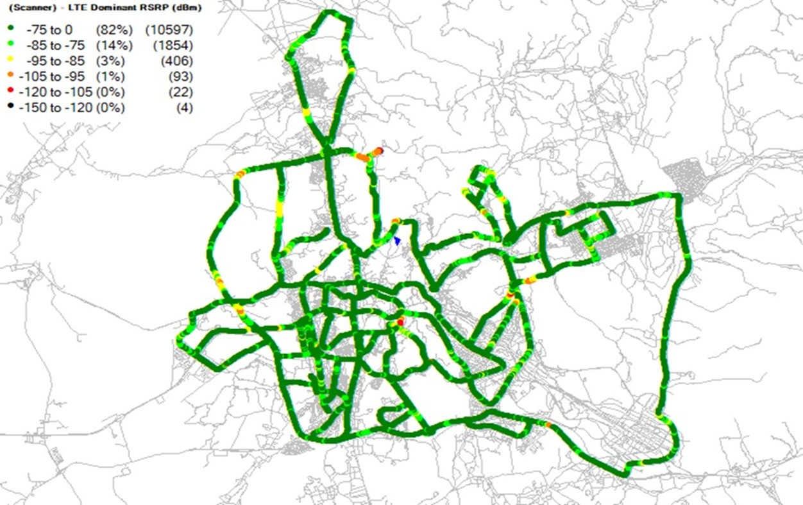
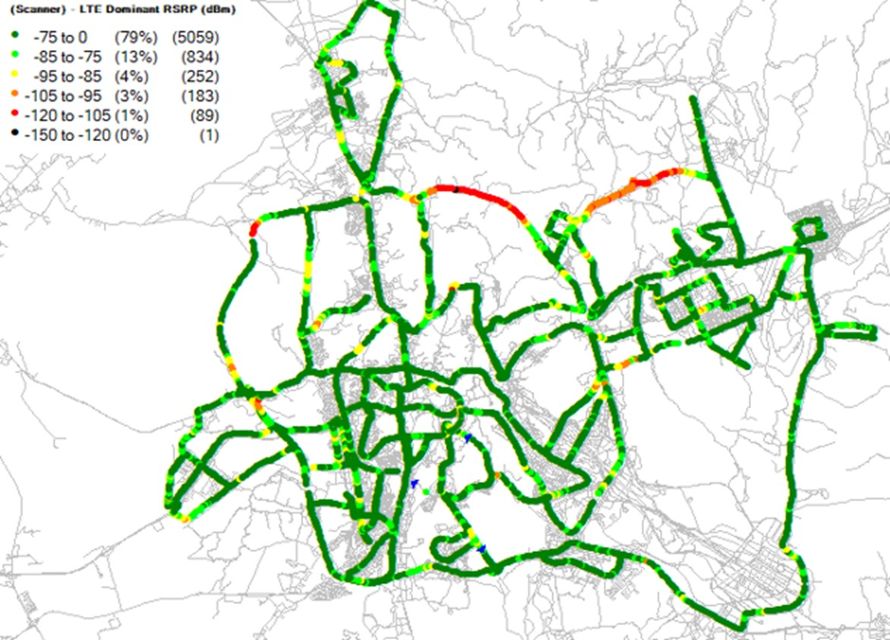
Makkah VIR 4G Coverage Comparison
Nov-2021
Dec-2021
Jan-2022
4G-RSRP
New route was added on Feb Vir Drive
4th Ring road which has no dedicated sites
New planned site ZMK920 and ZMK861 will cover 4th ring road
Feb-2022

Slide 16
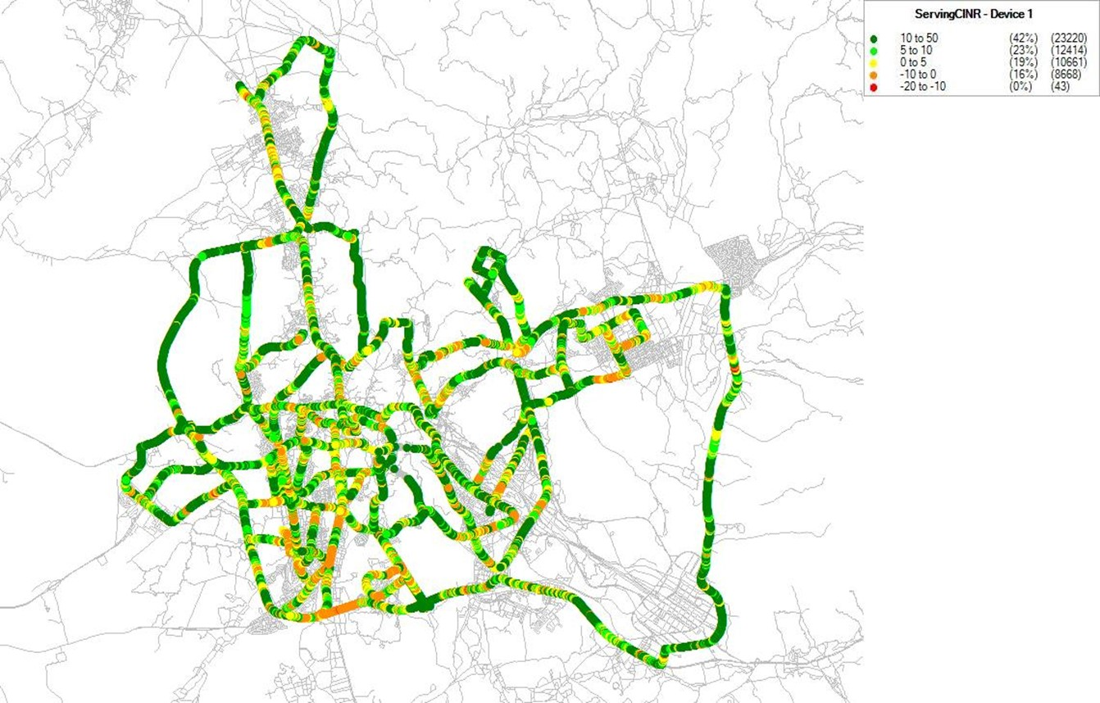
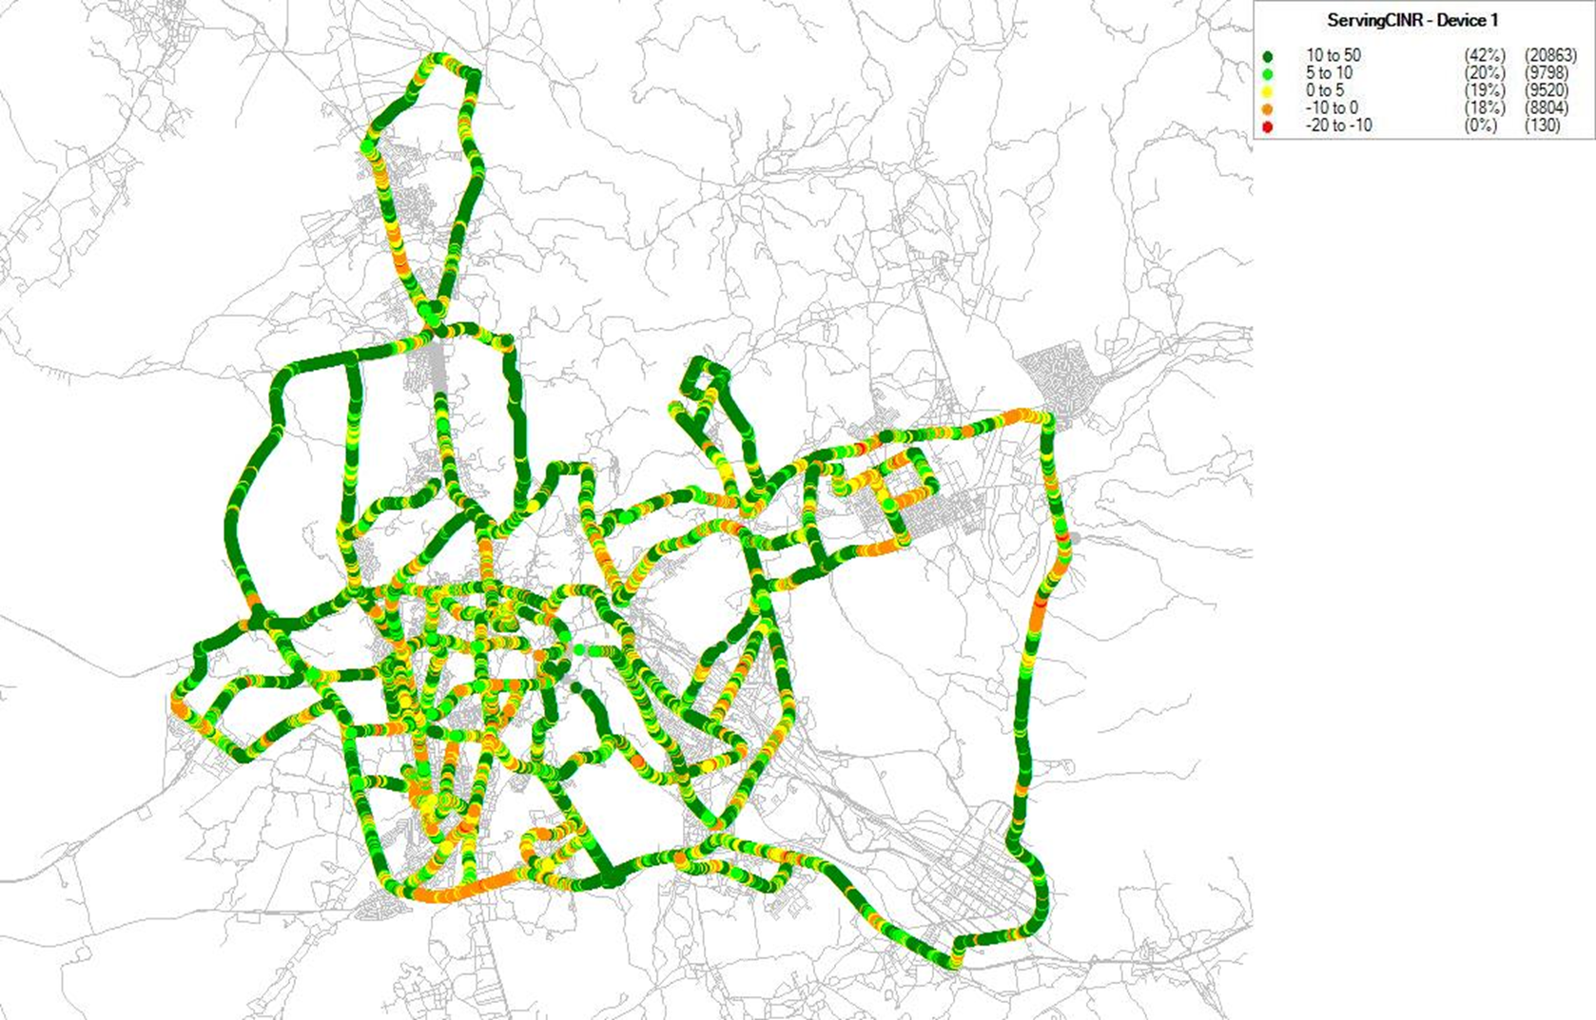
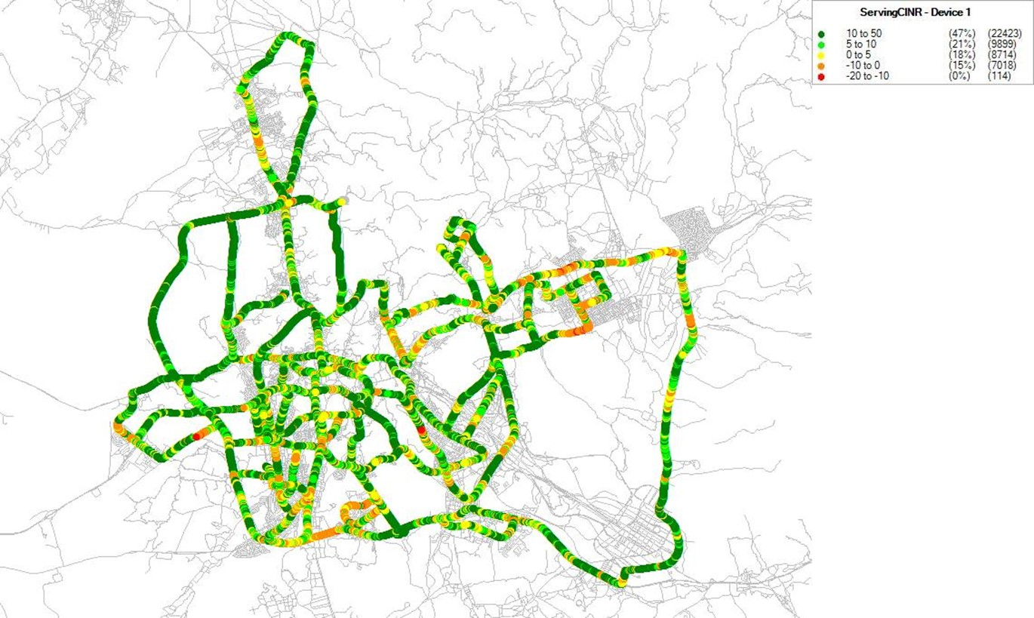
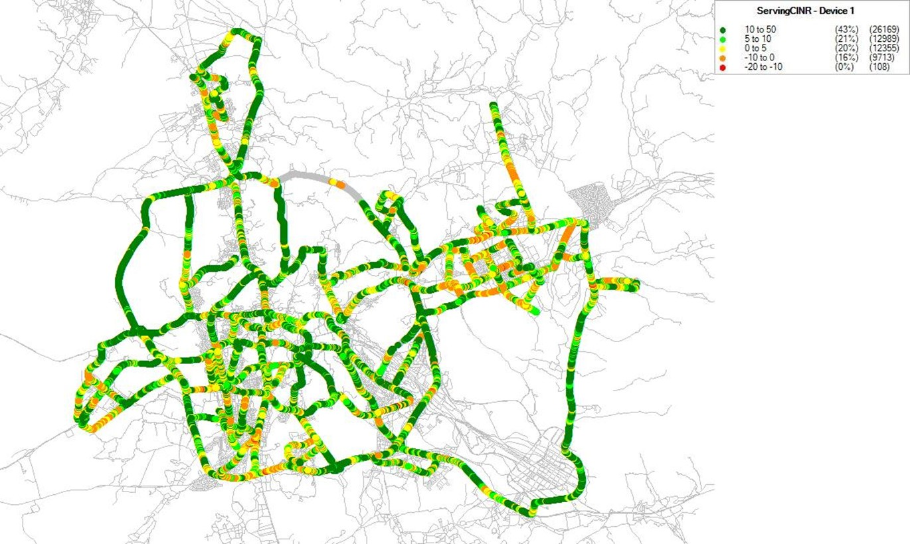
Makkah VIR 4G SINR Comparison
Nov-2021
Dec-2021
Jan-2022
4G-SINR
Feb-2022

Slide 17
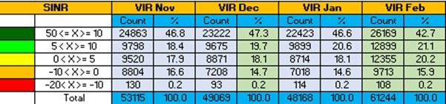
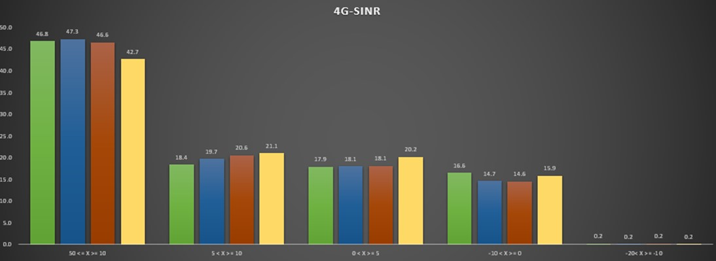
Makkah VIR 4G SINR Comparison

Slide 18
Makkah VIR 4G-VOLTE Events Comparison
No drop
No drop
No drop
No drop
Nov-2021
Dec-2021
Jan-2022
Feb-2022

Slide 19
Makkah VIR 4G-VOLTE Events Comparison
Events | Nov | Dec | Jan | Feb | Mac | April | May | June | July | Sept | Oct | Nov | Dec
Call Attempts | 250 | 19 | 246 | 20
Call End successfully | 250 | 19 | 246 | 20
Call Dropped | 0 | 0 | 0 | 0
Call re establishment | 6 | 4 | 5 | 4

Slide 20
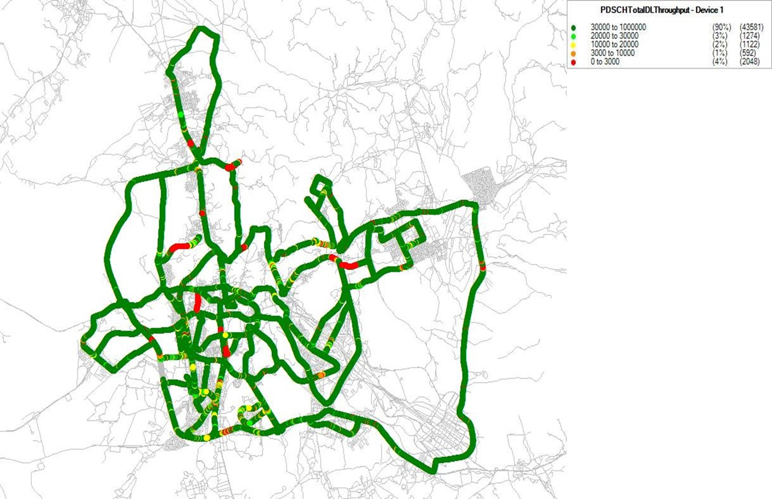


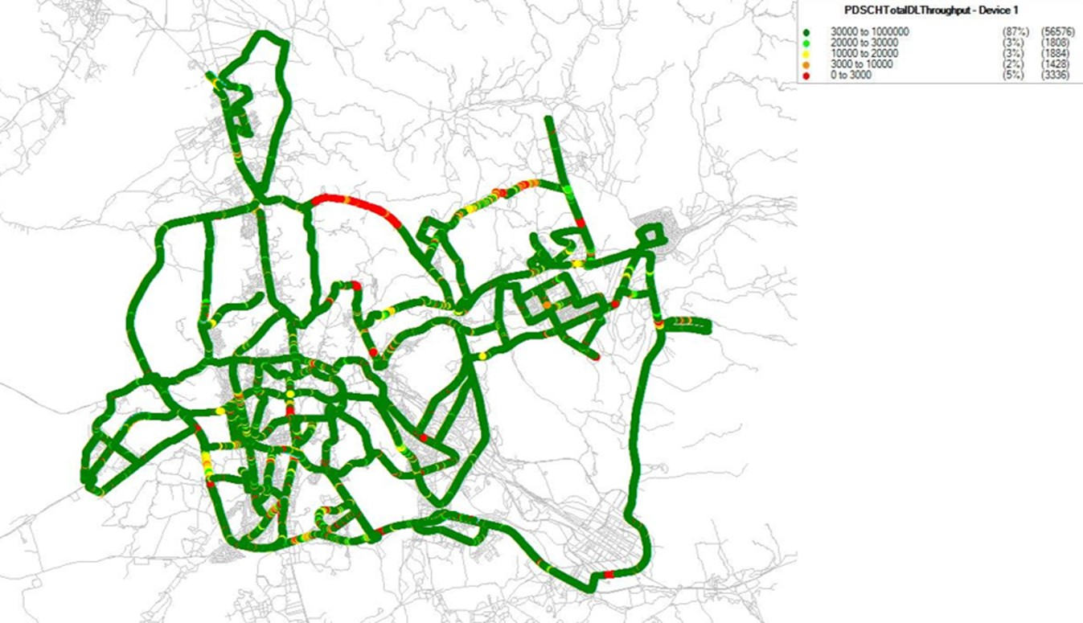
Makkah VIR 4G DL Throughput Comparison
Nov-2021
Dec-2021
Jan-2022
4G-DL Mbps
New route was added on Feb Vir Drive
4th Ring road which has no dedicated sites
New planned site ZMK920 and ZMK861 will cover 4th ring road
Feb-2022

Slide 21
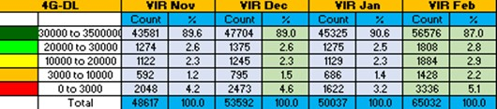
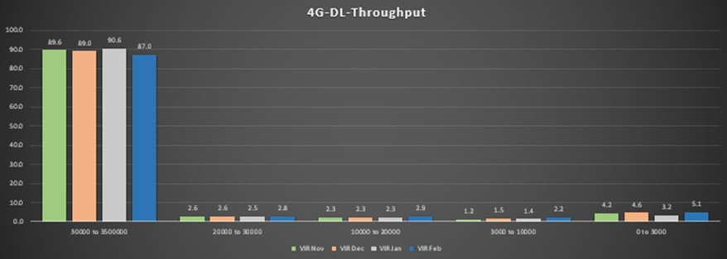
Makkah VIR 4G Throughput Comparison
For 4G throughput in normal trend from Nov 21 to Feb 22

Slide 22
5G
Makkah VIR

Slide 23
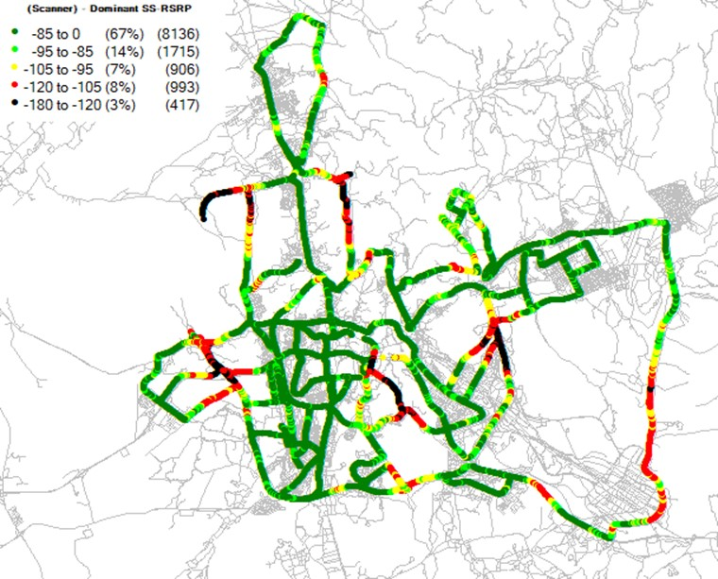
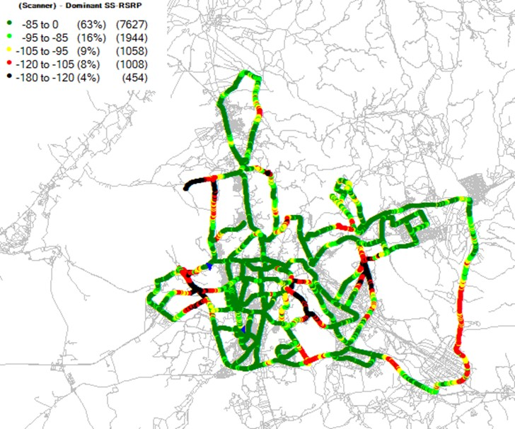
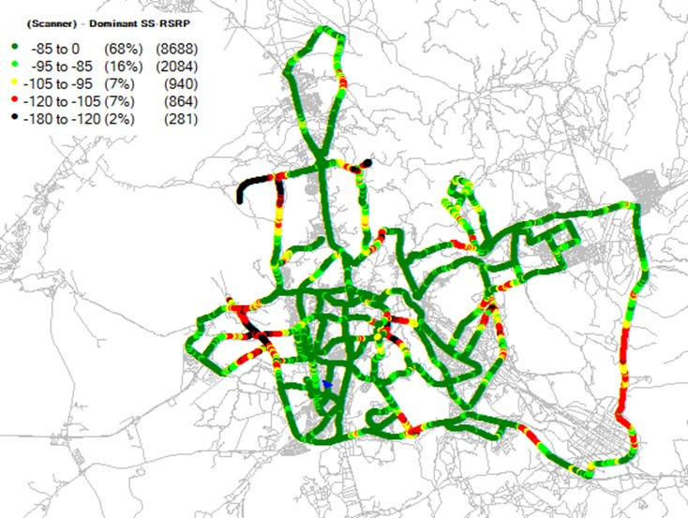
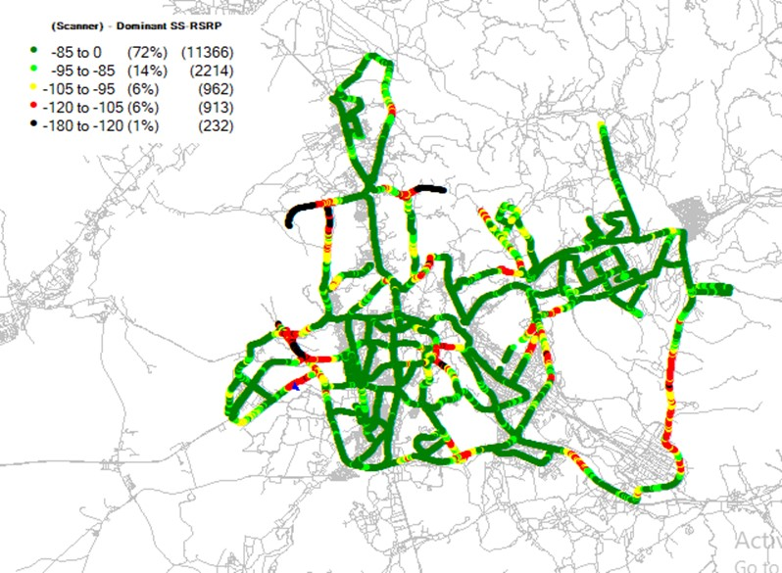
Makkah VIR 5G Scanner Coverage
Nov-2021
Dec-2021
Jan-2022
5G-RSRP
Feb-2022

Slide 24
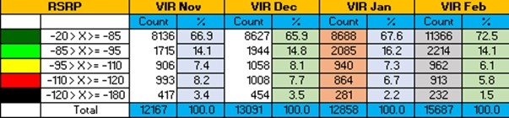
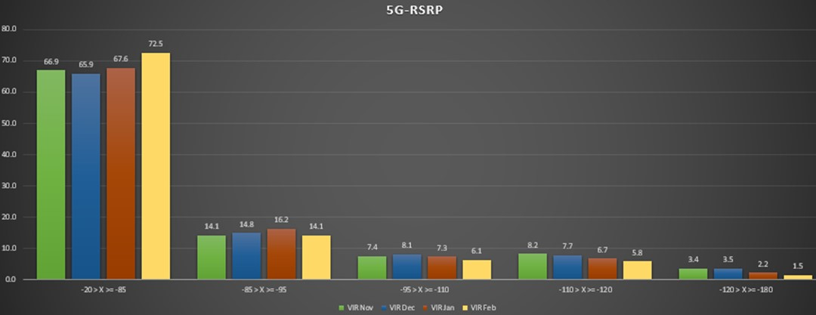
Makkah VIR 5G Scanner Coverage
With collocation 5G sites ongoing, coverage more improved.

Slide 25
Equipment / Scenario Test
 | Scenarios | IMEIs | Phone Model
1 | 2G LC MOC | 866241041862676 | OnePlus
2 | 2G LC MTC | 357221065141419 | Note 4
3 | 3G LC MOC | 357221065141419 | Note 4
4 | 3G LC MTC | 357221065282312 | Note 4
5 | VOLTE LC MOC | 352713091241580 | S9
6 | VOLTE LC MTC | 352713096220019 | S9
7 | FDD DL | 352713095685667 | Note 10+
8 | 3G DL | 357221065141419 | Note 4
9 | FM SC | 352713095685667 | Note 10+

Slide 26
Shukran!
شُكراً

